Slide 1
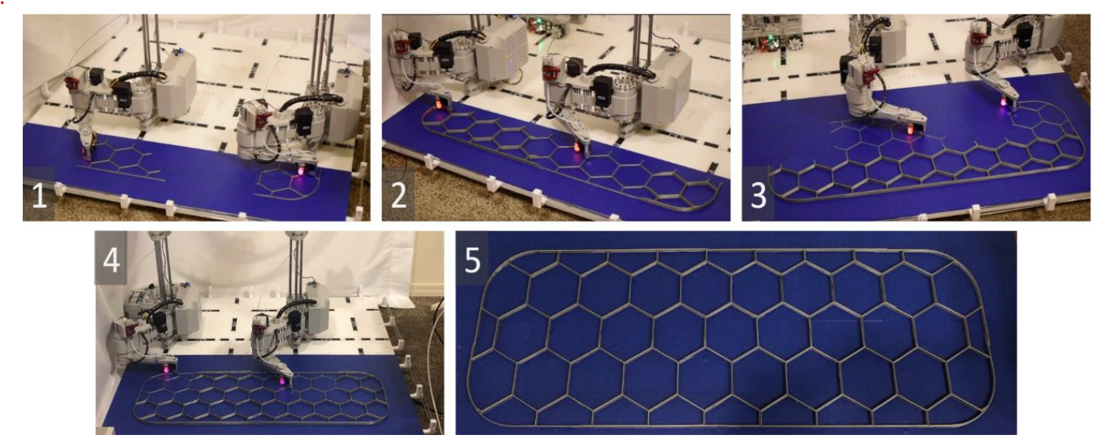
Initial Chunk
350 mm
1000 mm

